Slide 1
IB Math SL – Exponents
Ms. Haralampopoulos
October 27th 2016

Slide 10
Homework # 2

Slide 12
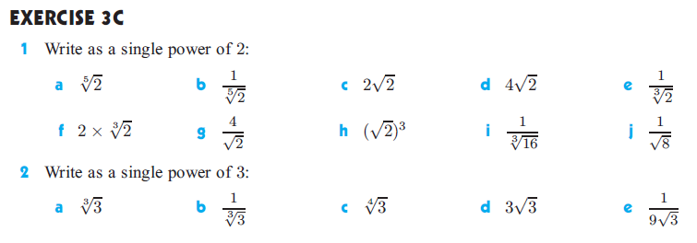

Slide 13
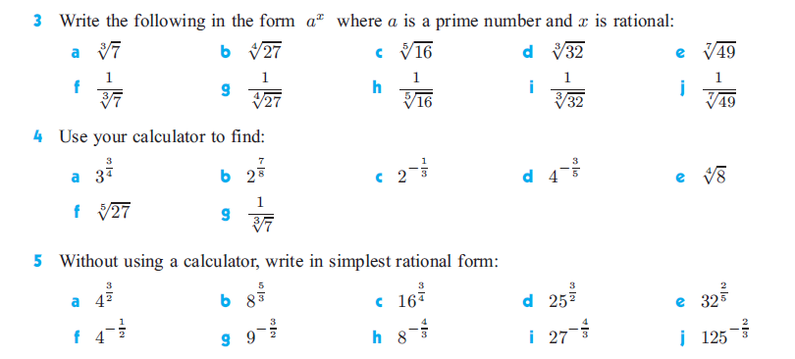

Slide 14
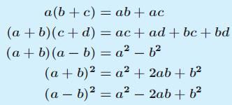
Expansion Laws

Slide 22
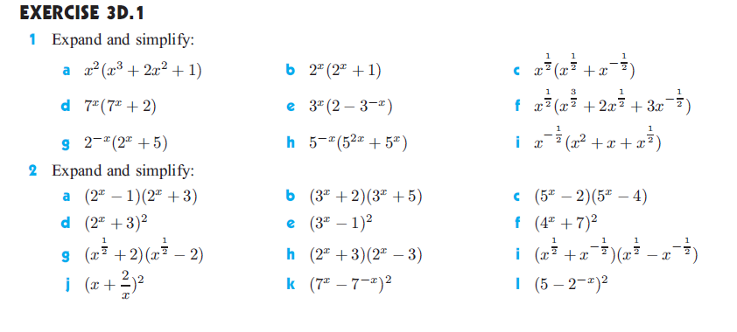
Homework #3

Slide 23
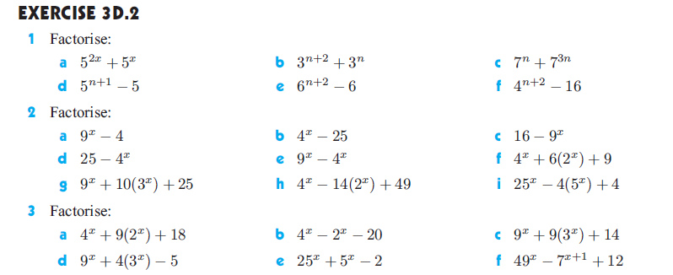
Homework #4

Slide 24
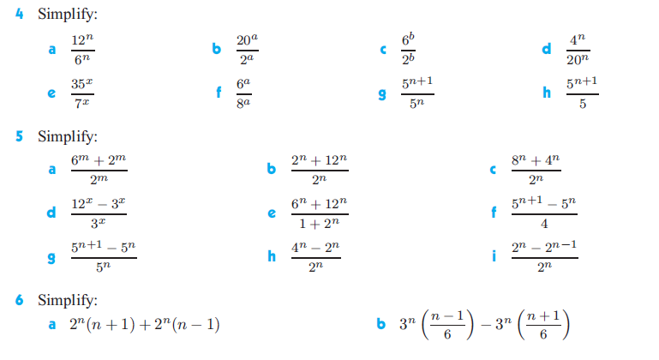
Homework #4

Slide 25
Homework # 5 – Review Guide with Sub

Slide 26
Homework #6

Slide 27
Homework #6

