Slide 1
IB Math SL – Functions
Ms. Haralampopoulos
October 5th 2016

Slide 2
A relation is any set of points which connect two variables.
A relation is often expressed in the form of an equation connecting the variables x and y.
In this case the relation is a set of points (x,y) in the Cartesian plane.

Slide 3
A function, sometimes called a mapping, is a relation in which no two different ordered pairs have the same x –coordinate.

Slide 12
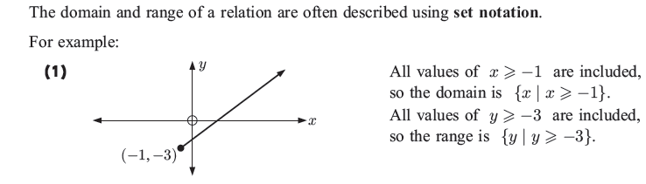
The domain of a relation is the set of x values
The range of a relation is the set of y values

Slide 13
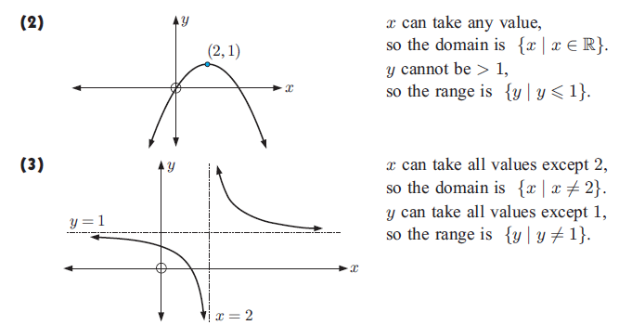

Slide 14
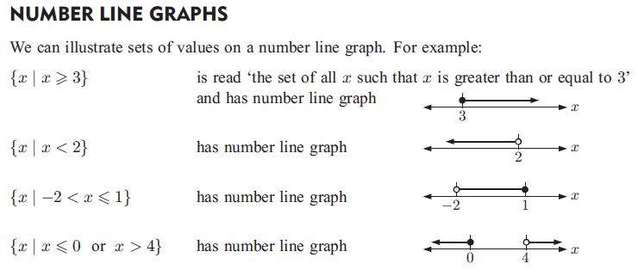


Slide 15

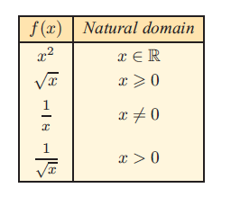

Slide 16
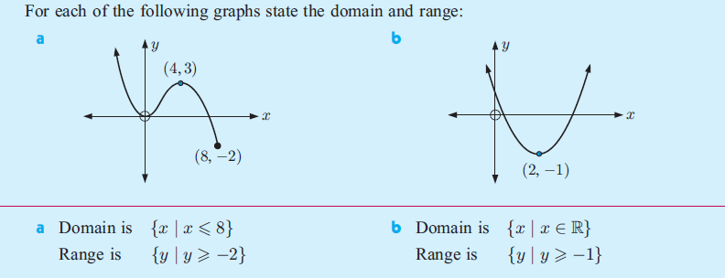

Slide 17

State the domain and range

Slide 18

State the domain and range

Slide 19

State the domain and range

Slide 20
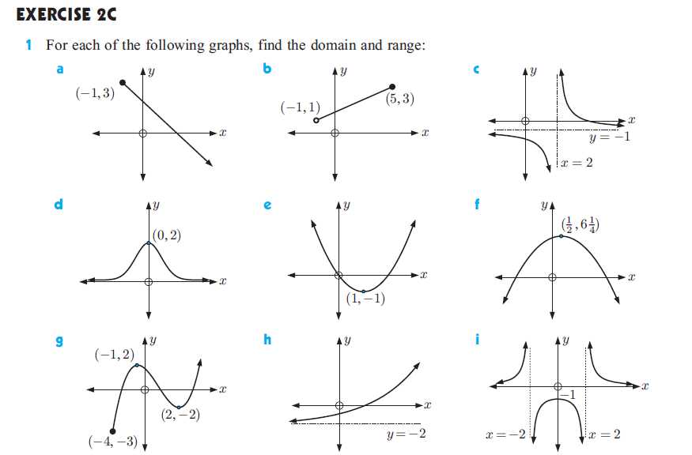

Slide 21

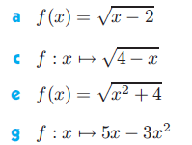
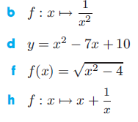
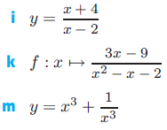
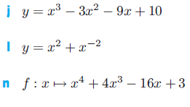

Slide 22



Slide 23
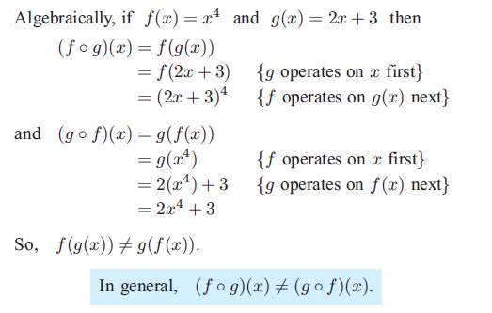

Slide 24


Slide 25


Slide 26
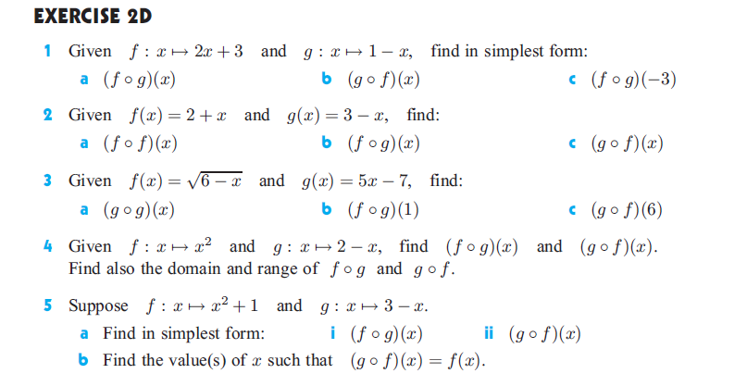

Slide 27



Slide 28
Solutions Homework #3

Slide 29
Tuesday October 10th Lesson

Slide 30
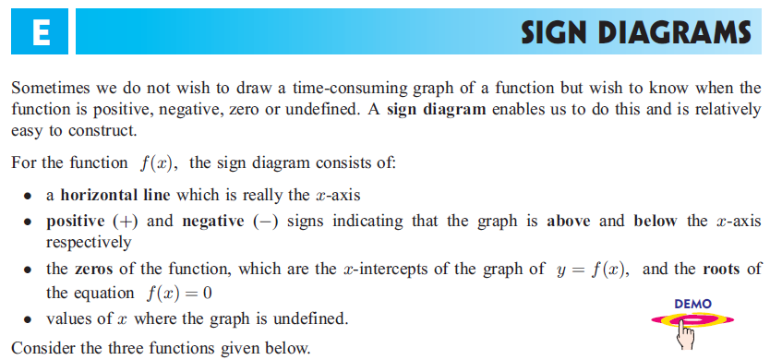

Slide 31
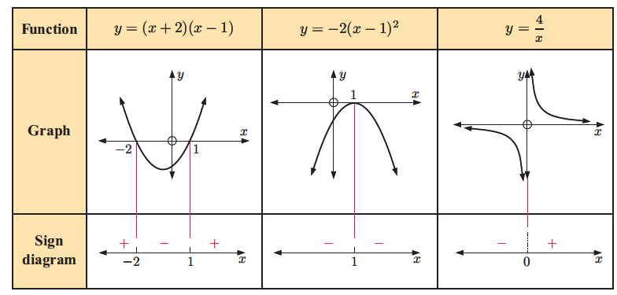

Slide 32



Slide 33
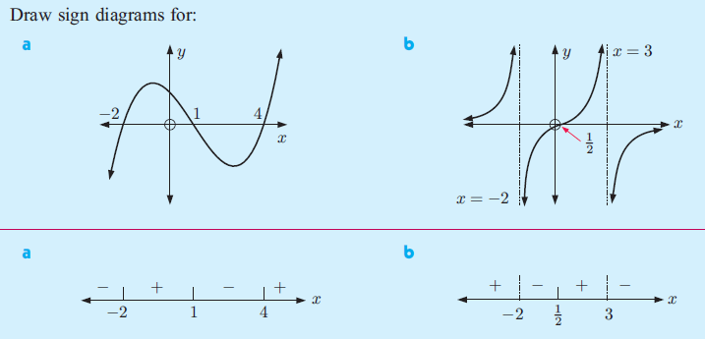

Slide 34
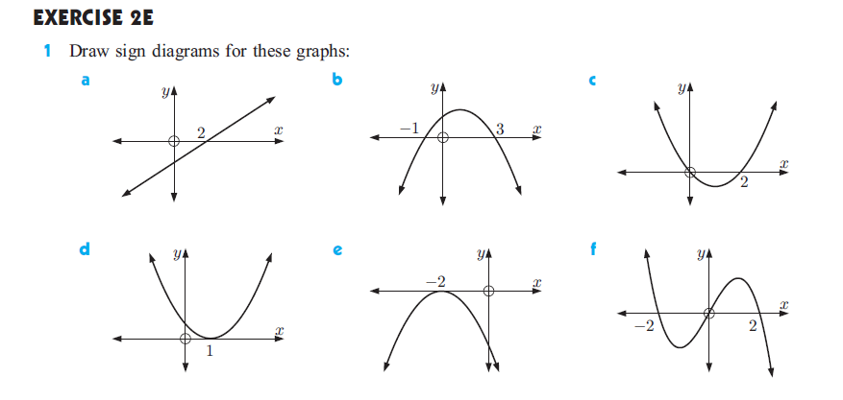
Tuesday 10/11 - Homework #4

Slide 35
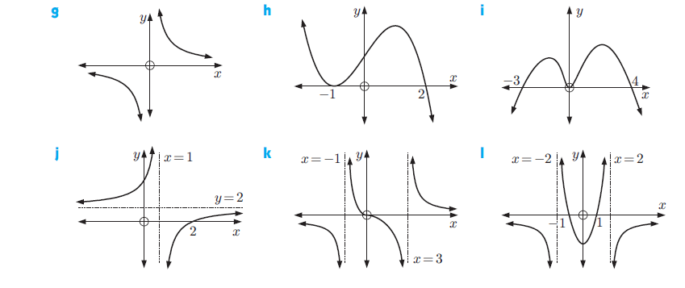
Homework #4 continued…

Slide 36
Solutions Homework #4

Slide 37
Wednesday October 12th Lesson

Slide 38
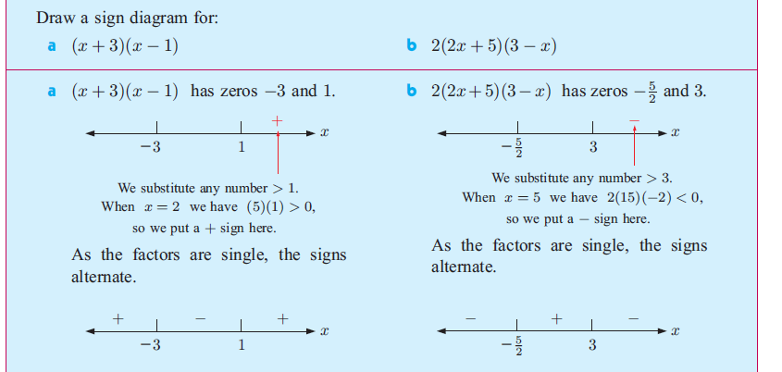

Slide 39
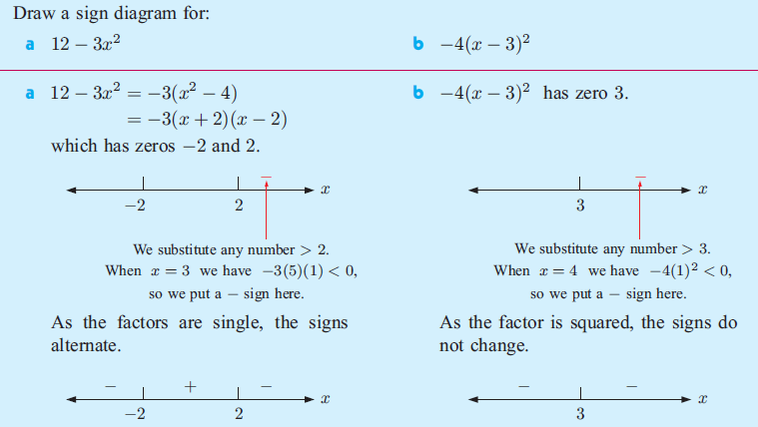

Slide 40



Slide 41
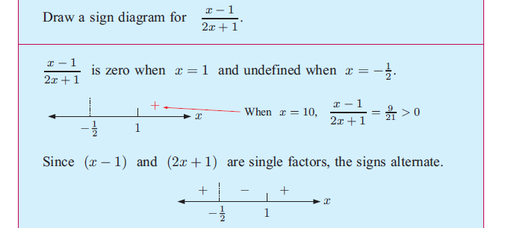

Slide 42


Slide 43
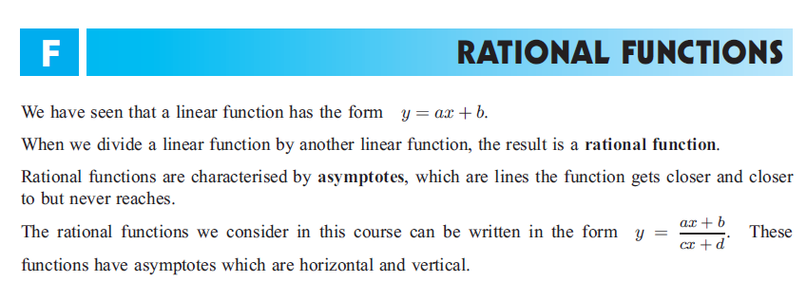

Slide 44


Slide 45
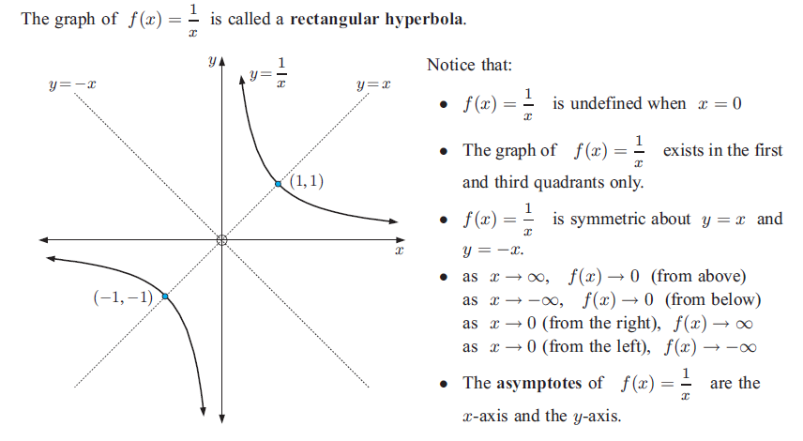

Slide 46
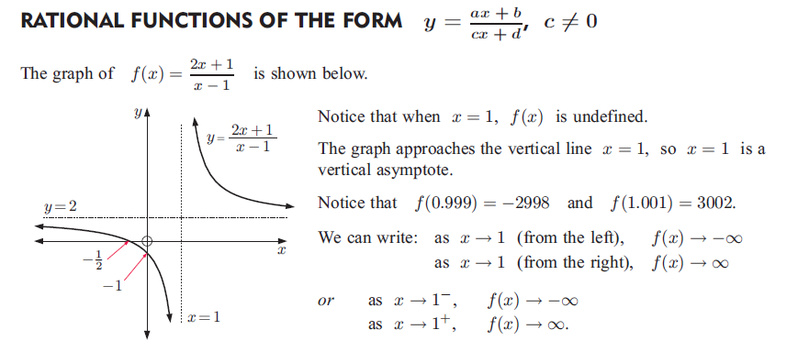

Slide 47
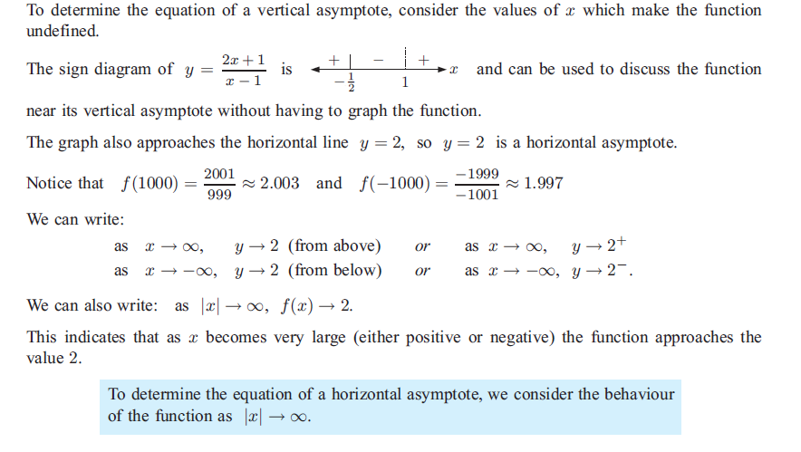

Slide 48
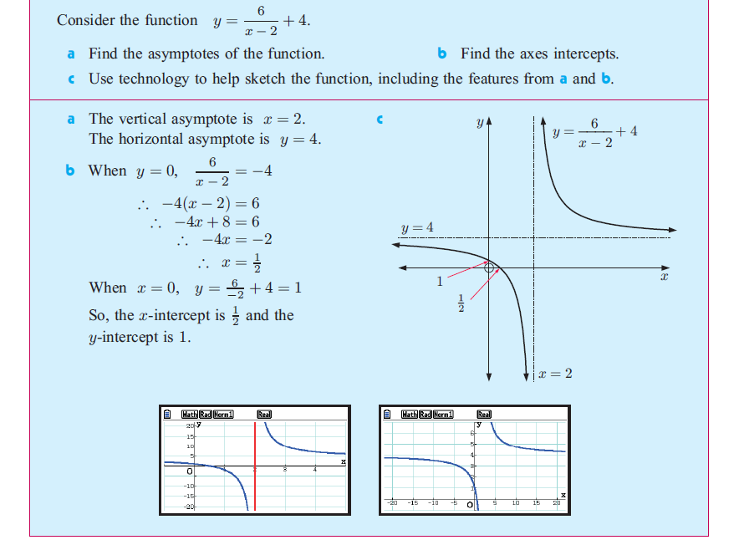

Slide 49
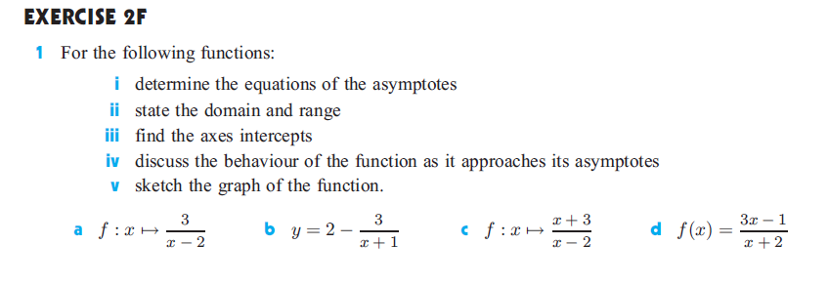


Slide 50
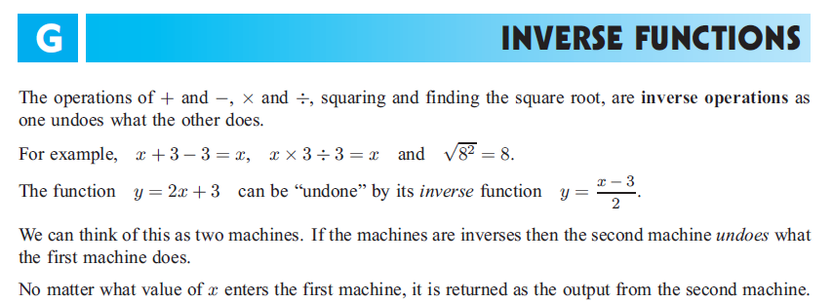

Slide 51


Slide 52
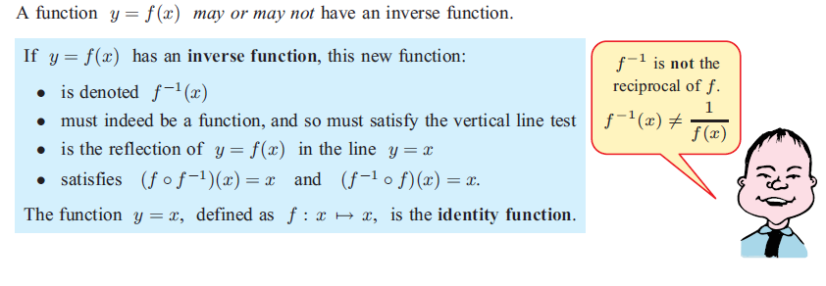

Slide 53
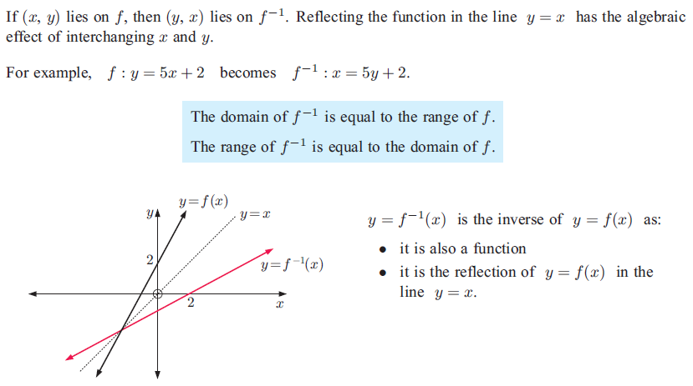

Slide 54
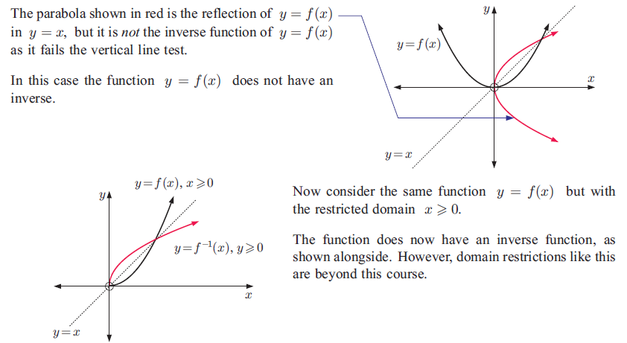

Slide 55


Slide 56
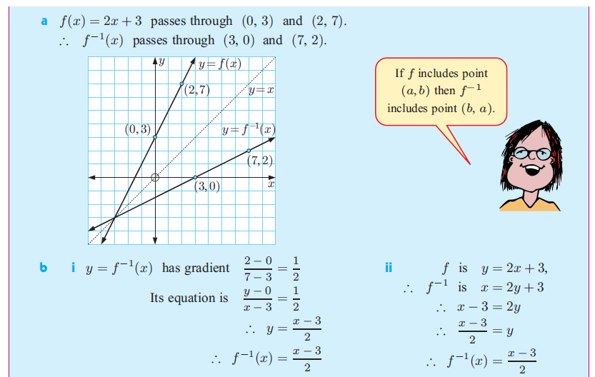

Slide 57


Slide 58


Slide 59



Slide 60
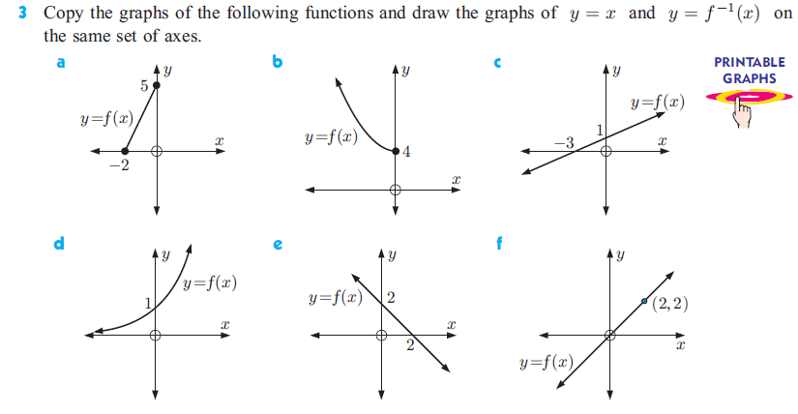

Slide 61
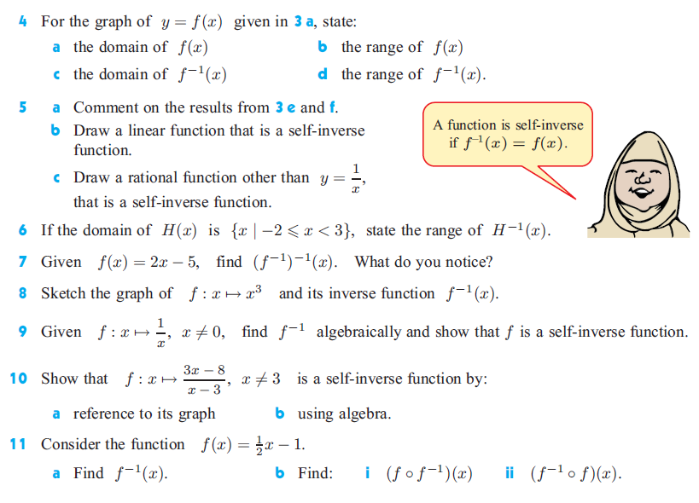

Slide 62
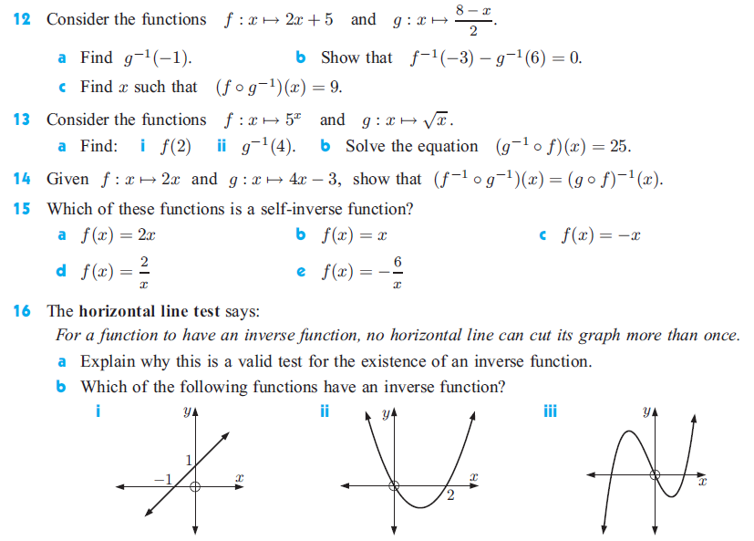

Slide 63
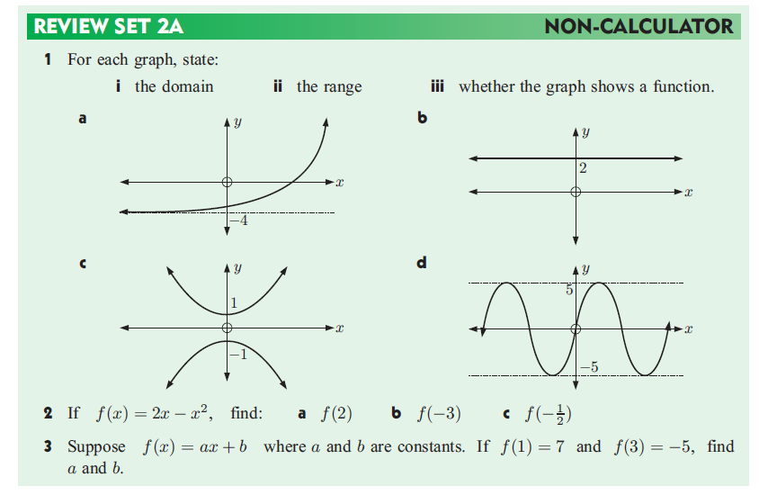

Slide 64
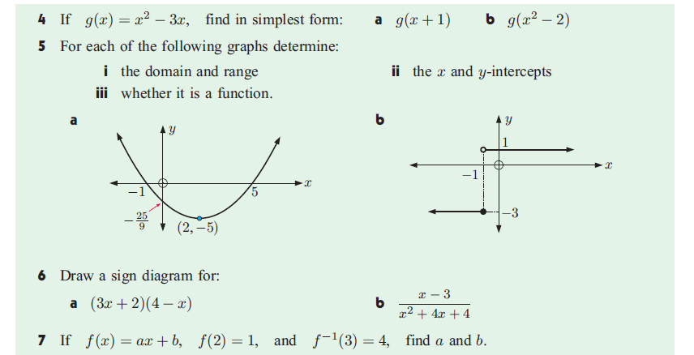

Slide 65
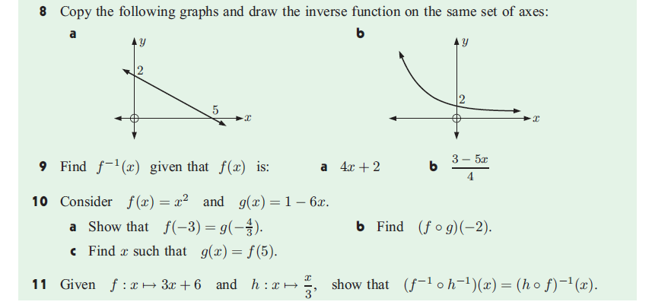

Slide 66
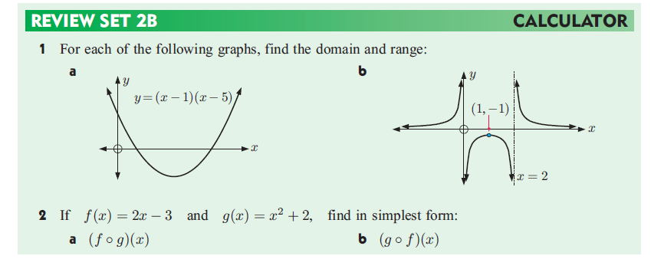
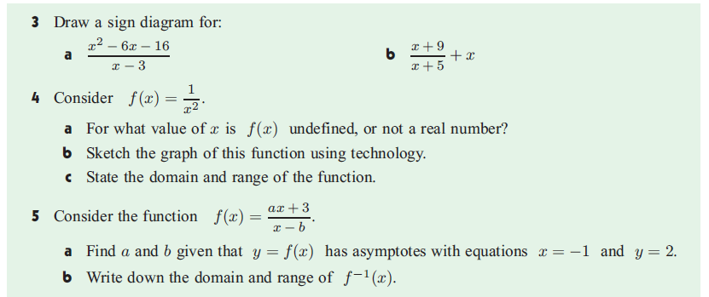

Slide 67
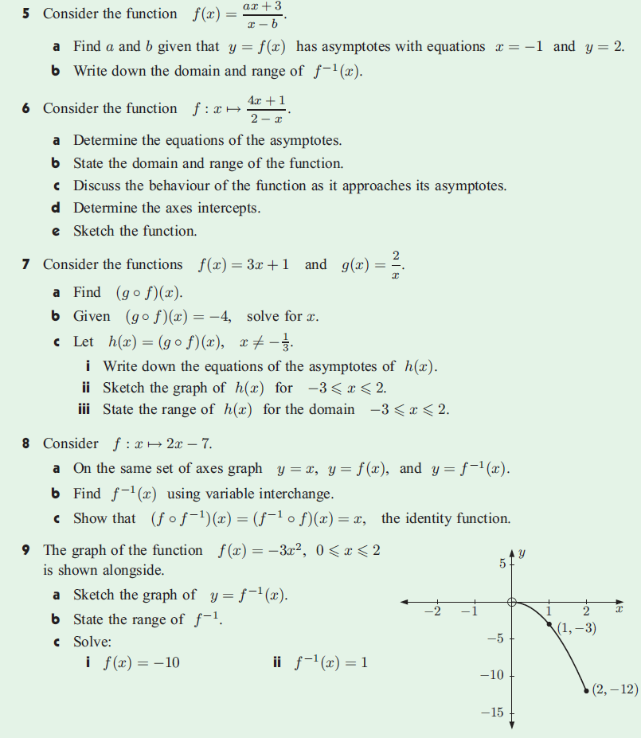

Slide 68
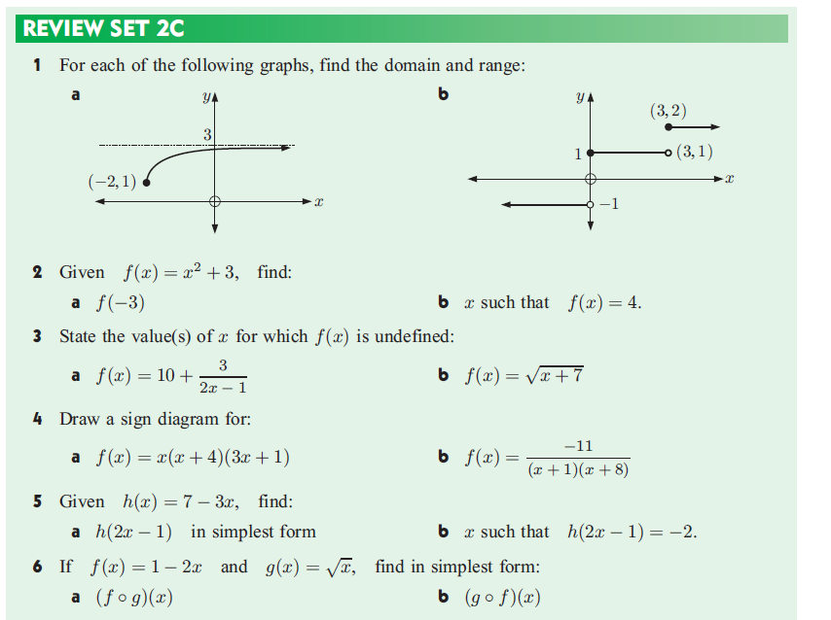

Slide 69
